Slide 1
Asteroids
By Ryan Wells

Slide 2
History
The game was created by Lyle Rains and programmed by Dominic Walsh.
It was a hit the USA when it was first launched and then ended up being Atari’s best selling game of all time.

Slide 3
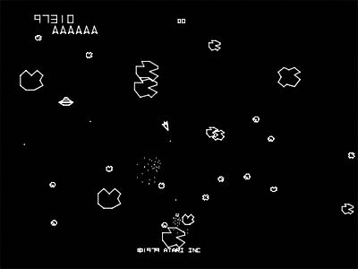
Original Game

Slide 4
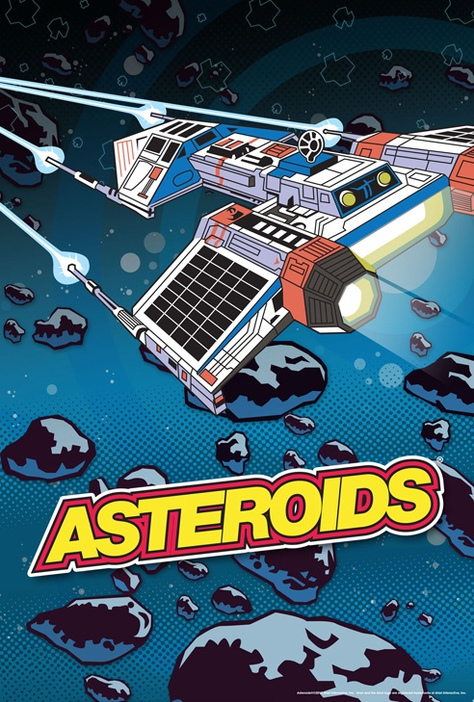
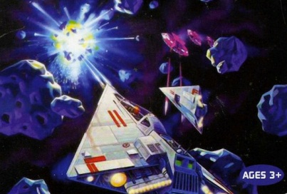
Advertisement

Slide 5
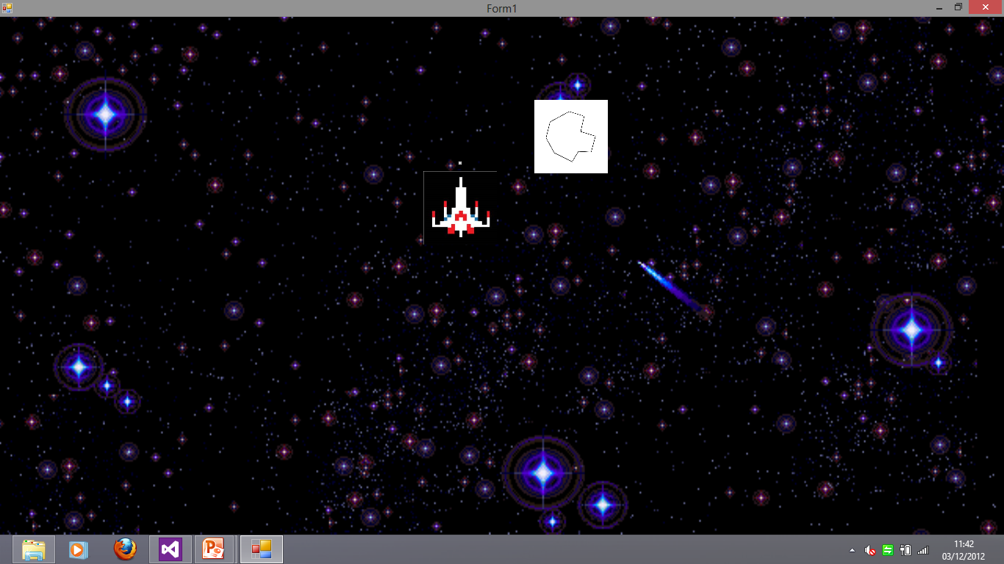
My Game

Slide 6
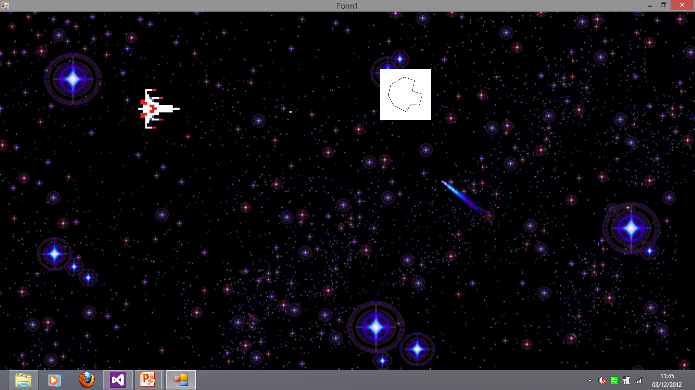

Slide 7
Improvements
Better Graphics
Explosions when bullet and asteroid collide
Add high score and lives for the player
Insert a Start screen and game over screen
This is a basic game which has potential because it has a lot of room for improvement.

